Slide 1
Training and Placement System.
Group : Project Guide:
Hiba Rajguru Prof. Rujata Chaudhari
Saurabh Kolmabkar Prof. Anagha Aher
Omkar Shelar

Slide 2
Abstract
The 'Training and Placement' is developed for proper management of placements activities in our campus.
This project provides in-detail information of companies and student information at various user levels.
Student handbook database is taken as input for resume builder feature.
TPO officer controls major part of information flow in this system.

Slide 3
Introduction
This project aims at developing a online portal for training and placement dept. of the college.
The system is an online application that can be accessed throughout the organization and outside as well with proper login provided.
This system can be used as an application for the TPO of the college to manage the student information with regards to placement.

Slide 4
Problem statement
Manual management of training and placement activities.
Difficult for the training and placement officer for maintaining records.
Verification of student documents is time consuming.
Notifications about upcoming drives, placement procedures or expert talks may or may not reach the students.

Slide 5
Project Scope

Slide 6
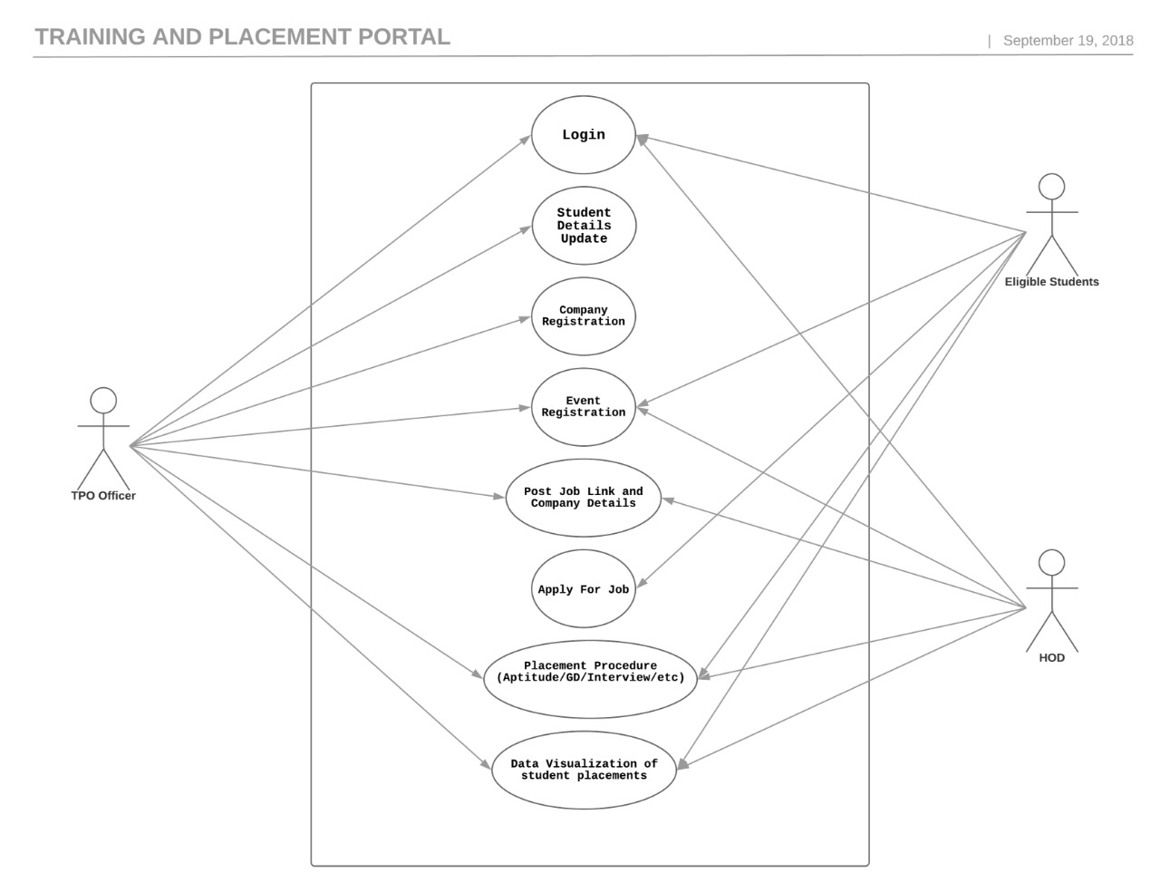
Use case diagram

Slide 8
Project Plan

Slide 9
Summary

Slide 10
Reference
2nd Int'l Conf. on Electrical Engineering and Information & Communication Technology (ICEEICT) 2015 Iahangirnagar University, Dhaka-1342, Bangladesh, 21-23 May 2015
Anjali.V et al, / (IJCSIT) International Journal of Computer Science and Information Technologies, Vol. 7 (2) , 2016, 760-763
Gunderloy, Jorden BPB Publications (2000) - “Mastering SQL Server” 2. Luke Welling and Laura Thomson (5th Edition) - “PHP and MySQL Web Development” 3. Roger S.Pressmen, T. Mc. GH. – Software Engineering (Theoretical Approach) 4. Thereon Willis wrox publications (2000) - “Beginning SQL Server”

